Slide 1
Whats New in SLDS
2020 GSIS

Slide 2
Perkins V
Released March 1st

Slide 4
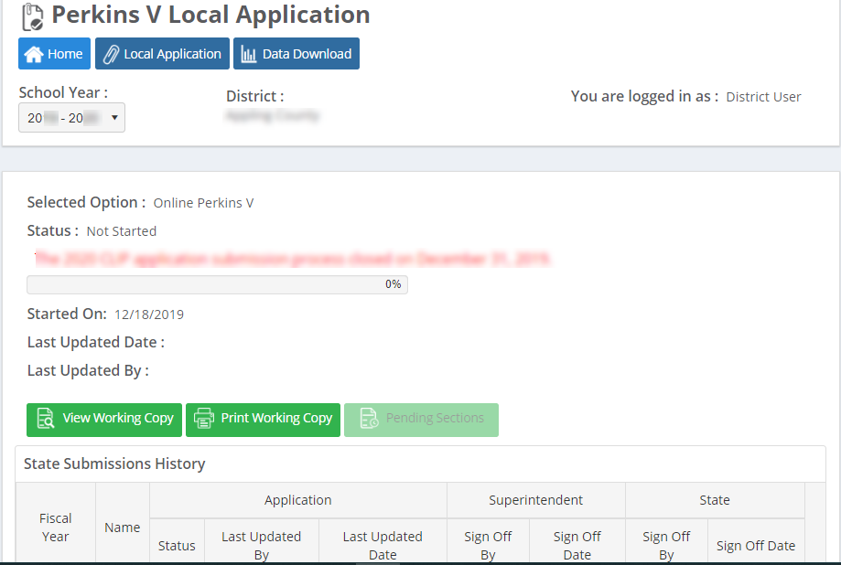

Slide 5
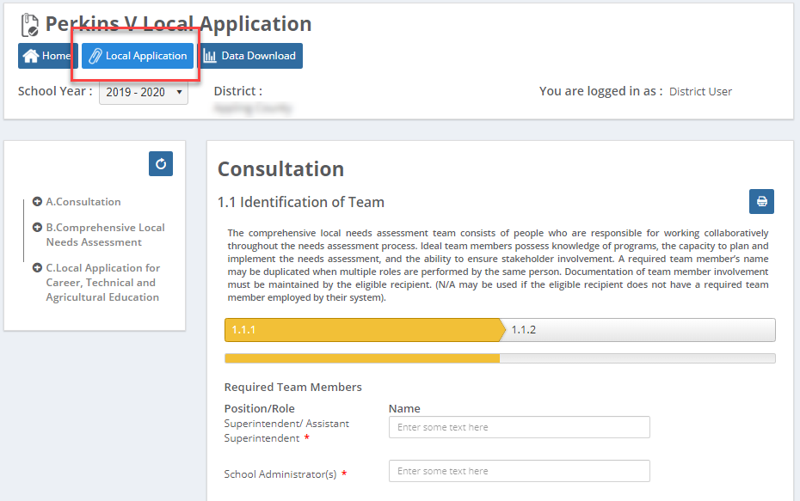

Slide 6
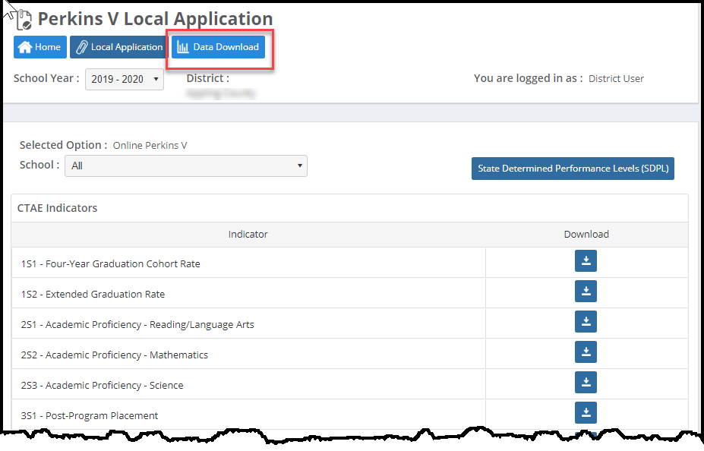

Slide 7
Progress Monitoring (CLIP) & Cross Functional Monitoring

Slide 10
Home School Report State View

Slide 11
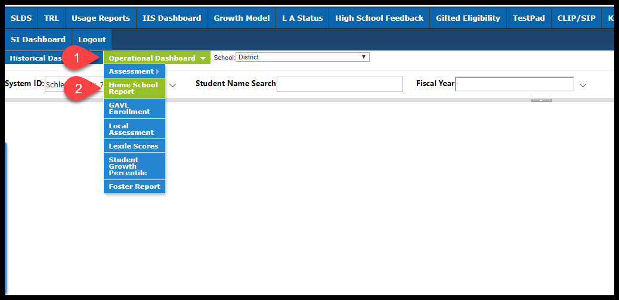

Slide 13
Be aware that you will need to scroll RIGHT even way off the screen to see the View Report button.

Slide 14
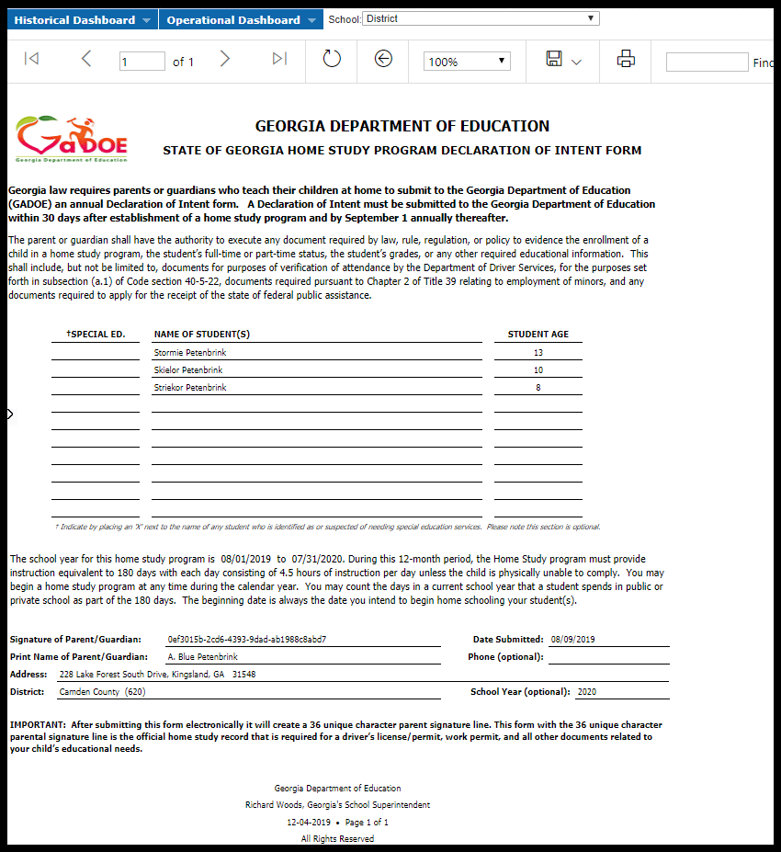

Slide 15
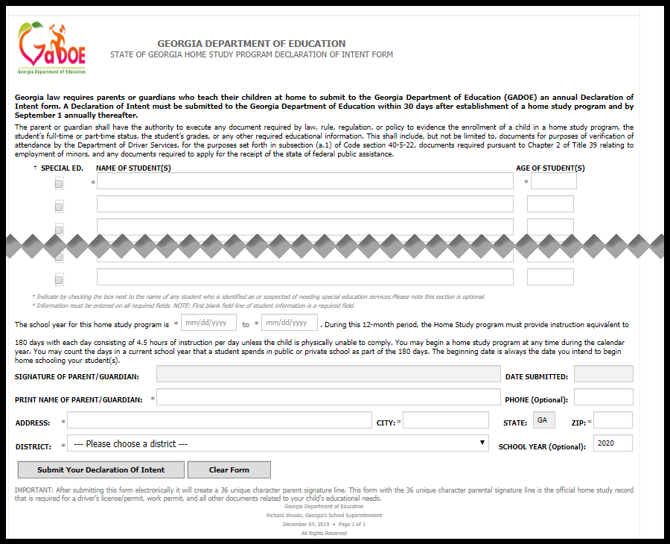
https://www.gadoe.org/Curriculum-Instruction-and-Assessment/Pages/Home-Study-DOI.aspx

Slide 16
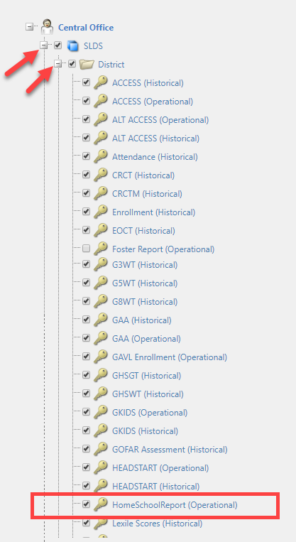
Only available with District Level access.

Slide 17
Teacher Dashboard

Slide 18
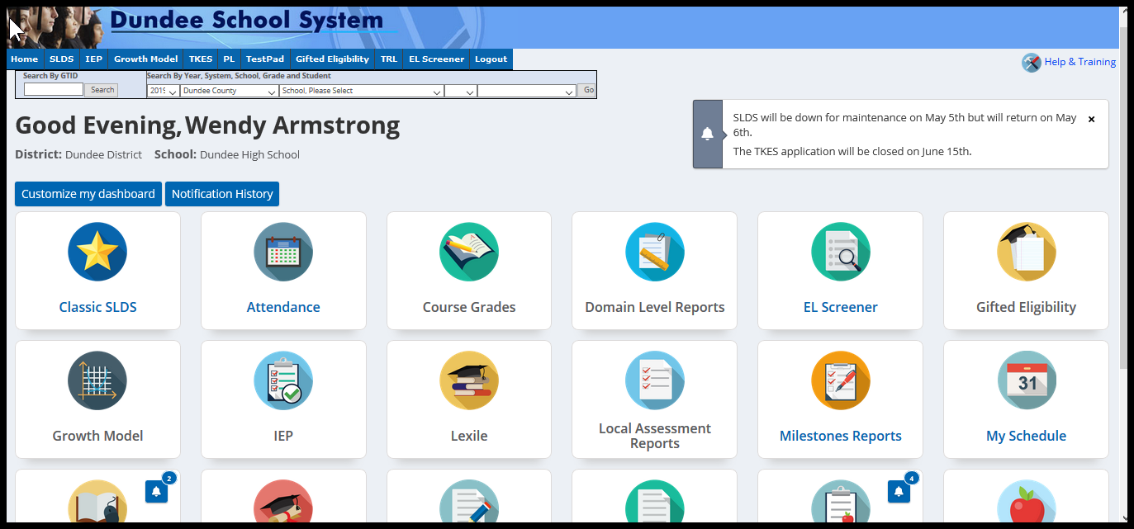

Slide 19
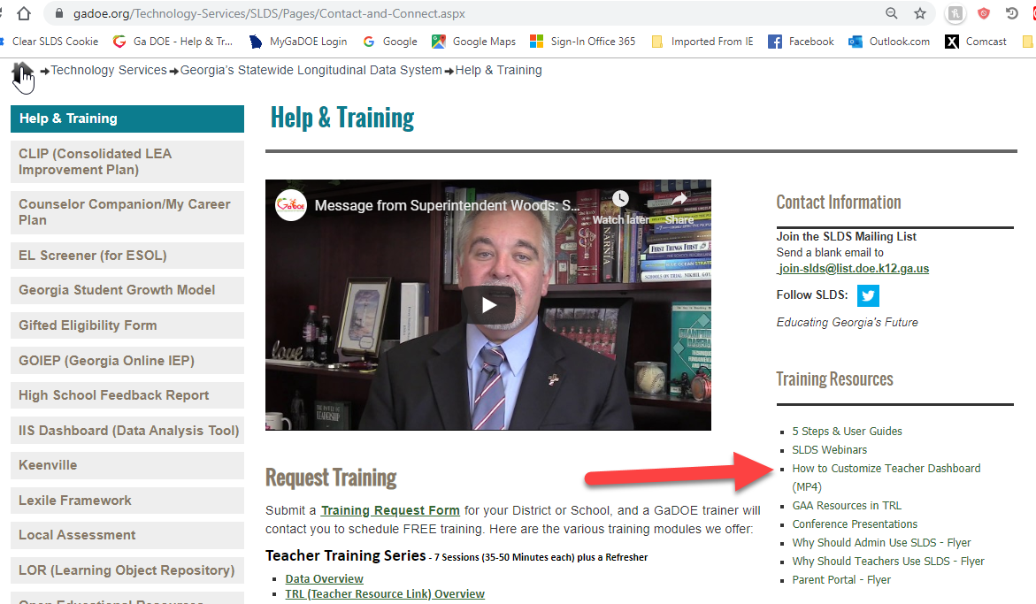

Slide 20
Parent Engagement

Slide 21
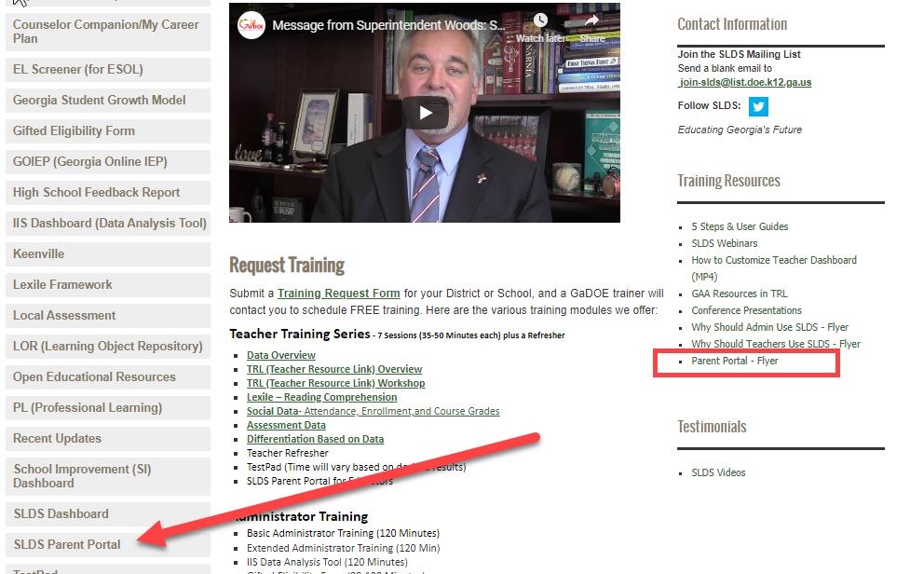

Slide 24
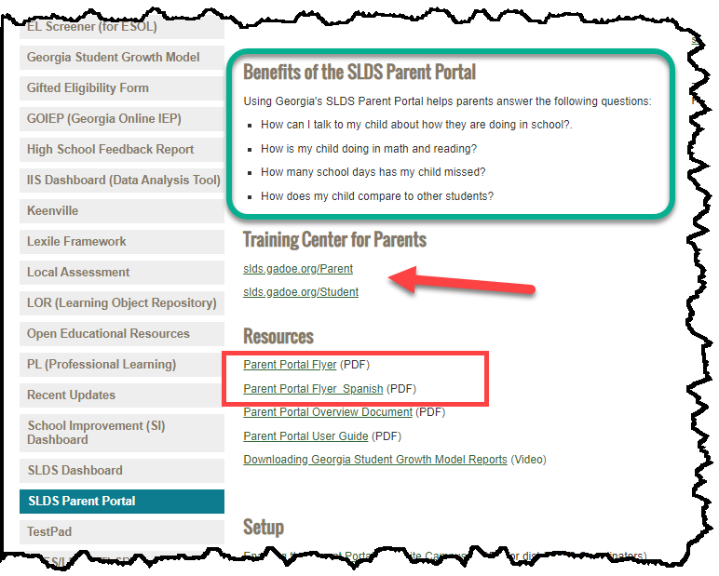
slds.gadoe.org/Parent
slds.gadoe.org/Student

Slide 25
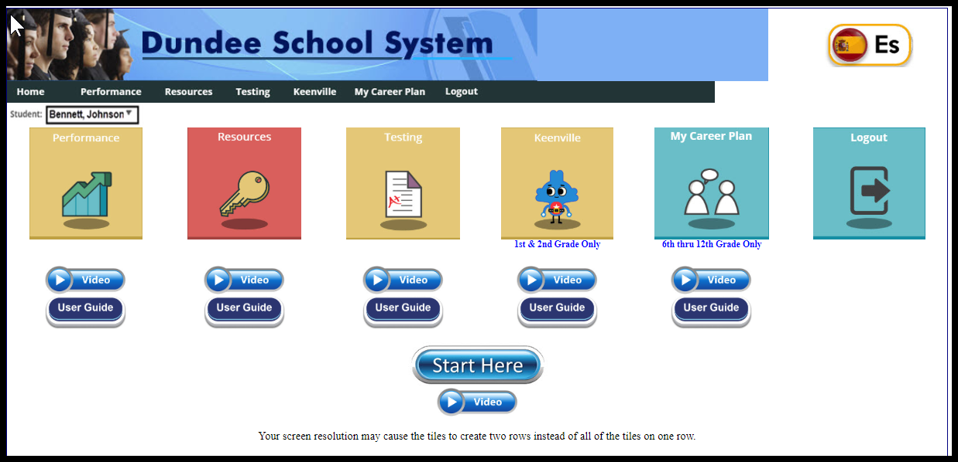
slds.gadoe.org/Parent
slds.gadoe.org/Student

Slide 26
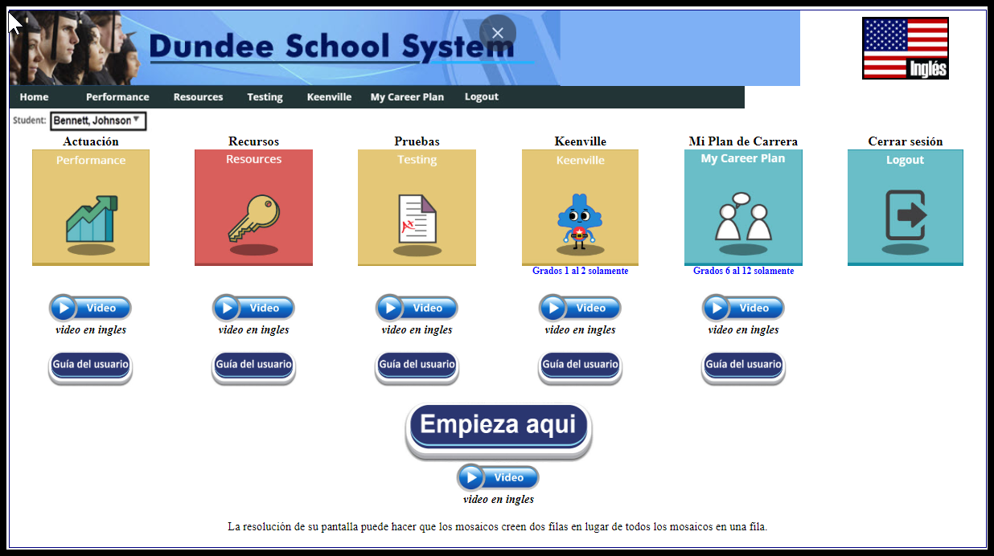

Slide 27
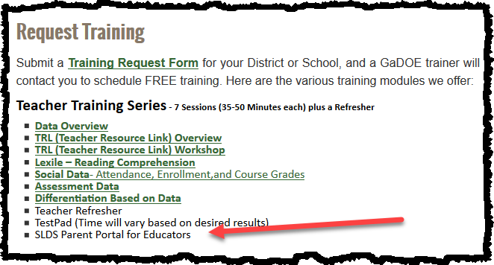

Slide 28
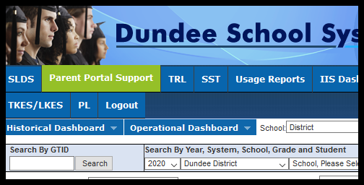

Slide 29
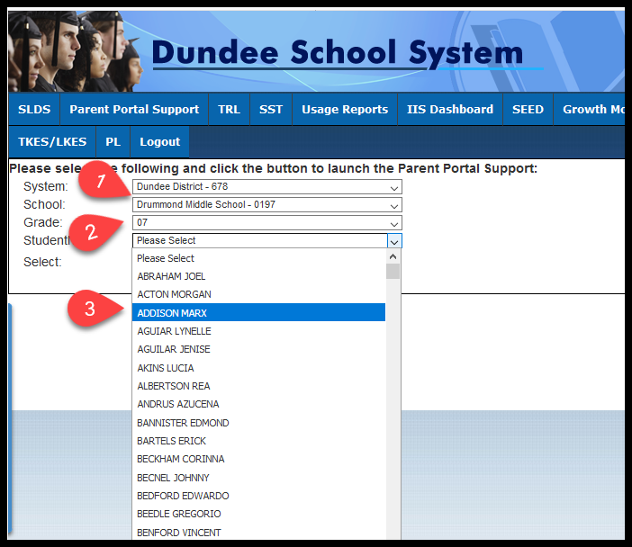

Slide 30
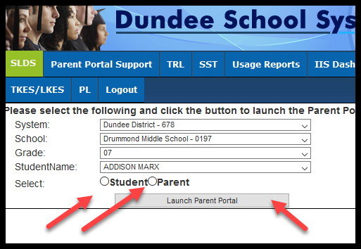

Slide 31
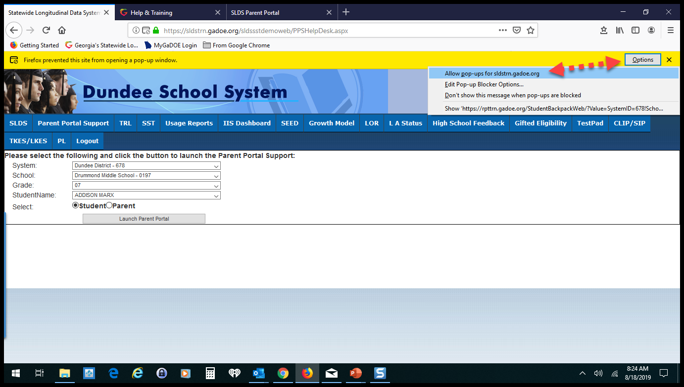

Slide 32
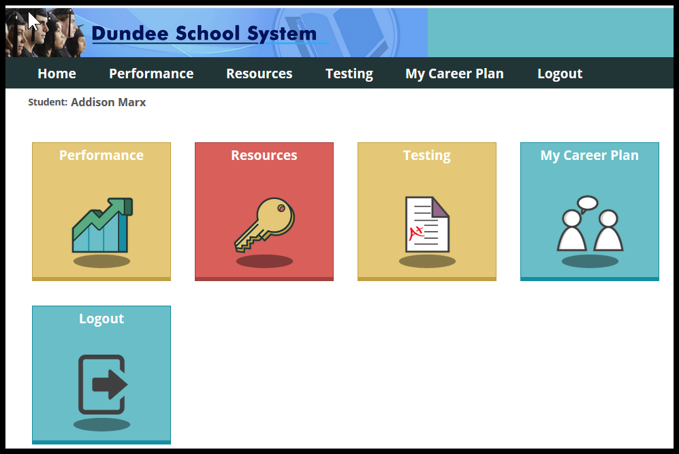

Slide 33
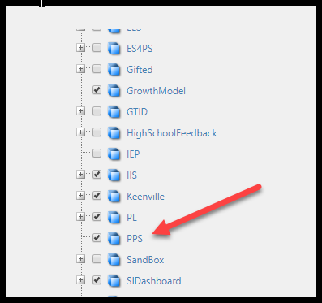
To turn on that feature for specific ROLES, just go into Profile Manager and click the PPS checkbox.

Slide 34
Foster Kids

Slide 35
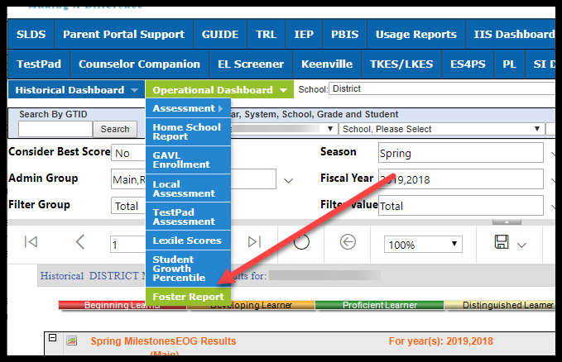
Foster Kids

Slide 36
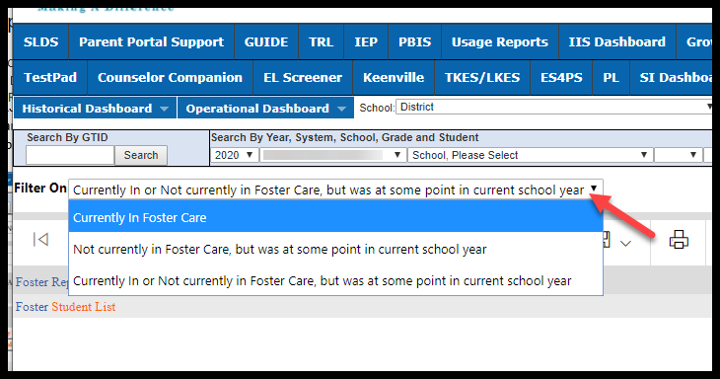

Slide 37
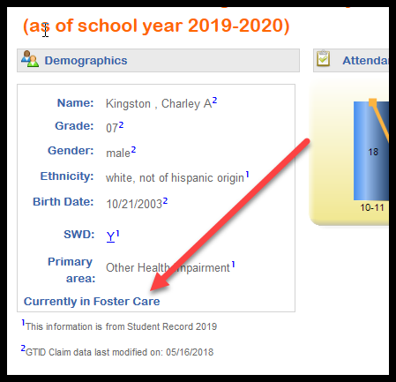
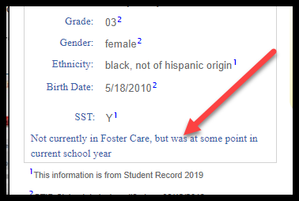
Student Profile Page

Slide 38
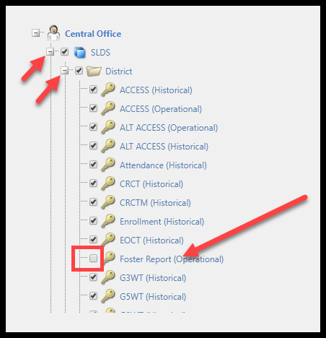

Slide 39
EL & Gifted Eligibility Form

Slide 40
Gifted & EL Forms – District Edit
We have made a BIG change in how Gifted & EL Screener forms are managed- but it is only a slight cosmetic change. Many Directors/Coordinators have asked for this change.
Now a district level “Approver” can make edits even AFTER the form has been approved (in the past the district had to request DOE to make those changes). The fear of making a mistake, resulted in many districts delaying the Approval process- now they don’t have to delay, because they can edit/correct forms locally.

Slide 41
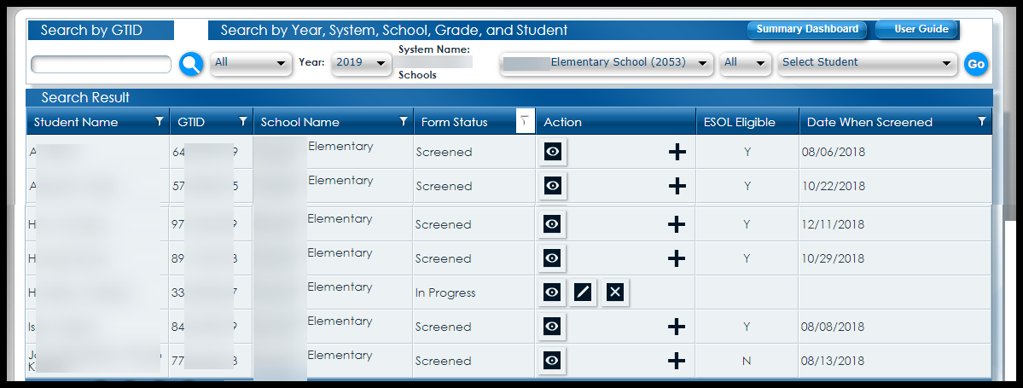
Gifted & EL Forms – Dynamic Icons

Slide 42
More Detailed Data

Slide 43
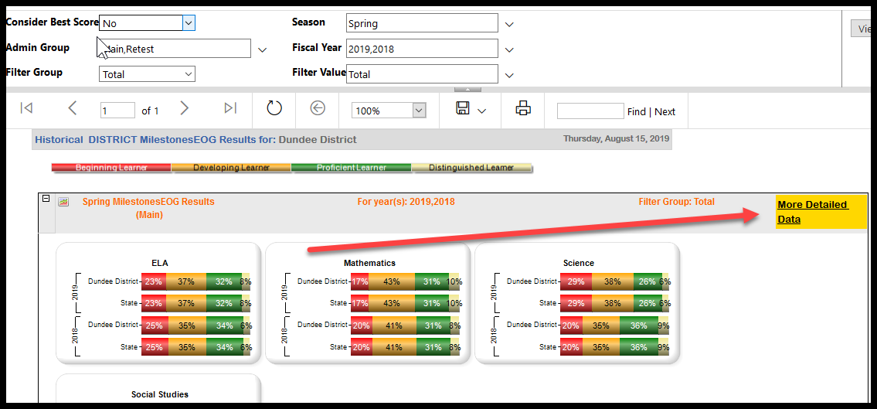

Slide 44
Enrollment Data

Slide 45
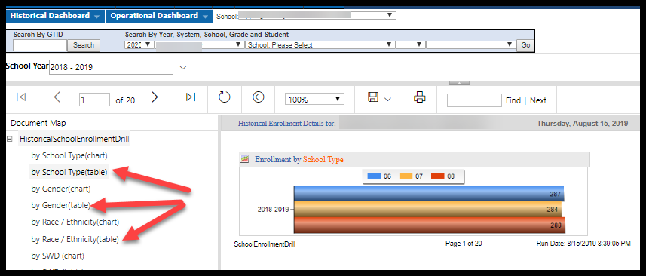

Slide 46
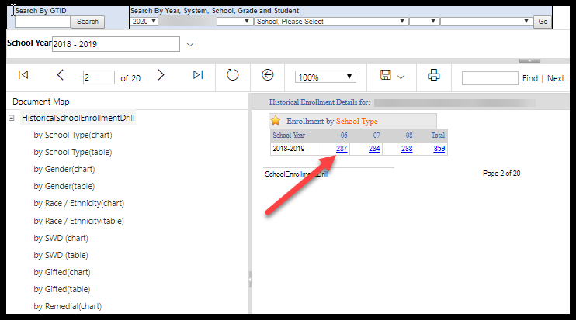

Slide 47
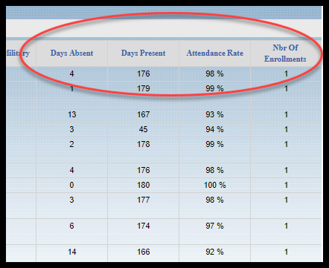
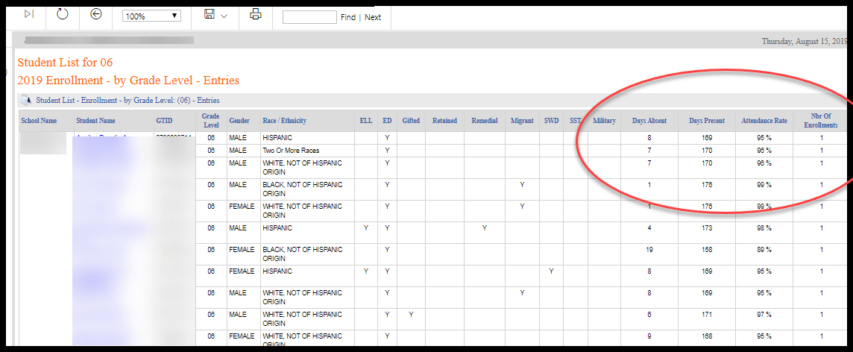

Slide 48
Student Growth Targets

Slide 49
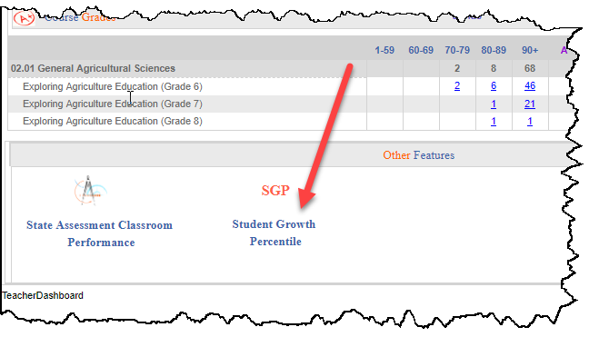

Slide 50
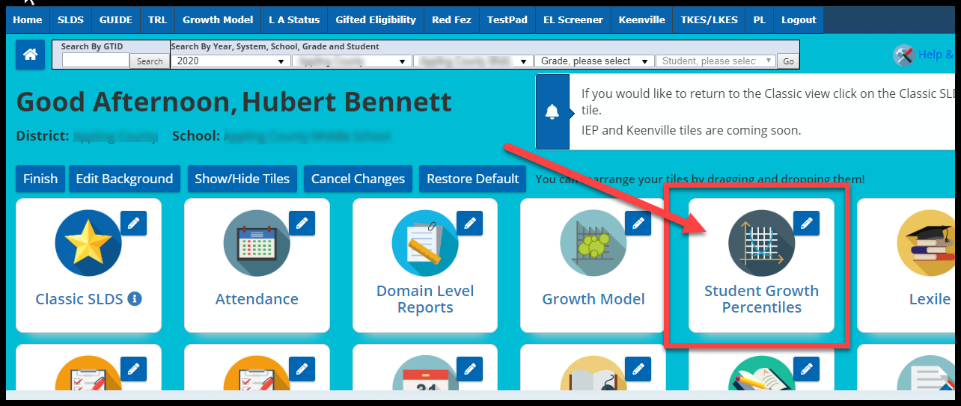

Slide 51
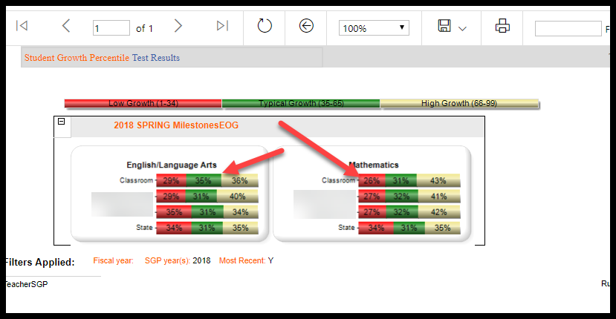

Slide 52
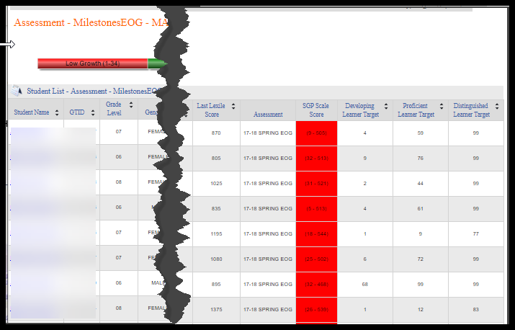

Slide 53
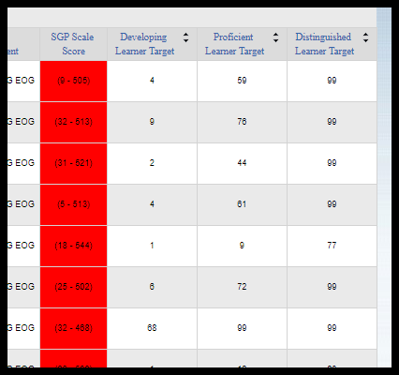

Slide 54
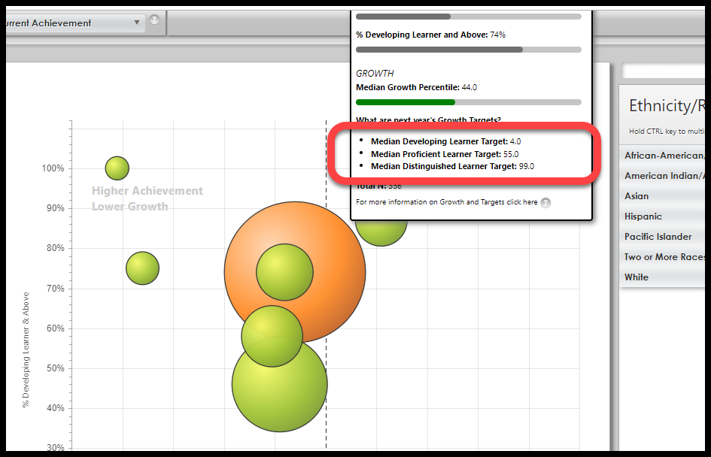
Where do the growth model targets come from?

Slide 55
Growth target explanation
Growth targets range from 1 to 99 and describe how much growth a student likely needs to be on the path to reach different achievement levels on the next assessment. In other words, growth targets tell us “if you grow this much (e.g., 70th percentile), you will likely reach this achievement level.” Three levels of targets are provided:
• Developing Learner Target: The amount of growth a student likely needs to demonstrate to become or remain a Developing Learner.
• Proficient Learner Target: The amount of growth a student likely needs to demonstrate to become or remain a Proficient Learner.
• Distinguished Learner Target: The amount of growth a student likely needs to demonstrate to become or remain a Distinguished Learner.
Growth targets are based on a one-year timeframe and are
recalculated each year.

Slide 56
Student Growth Percentage Reports

Slide 57
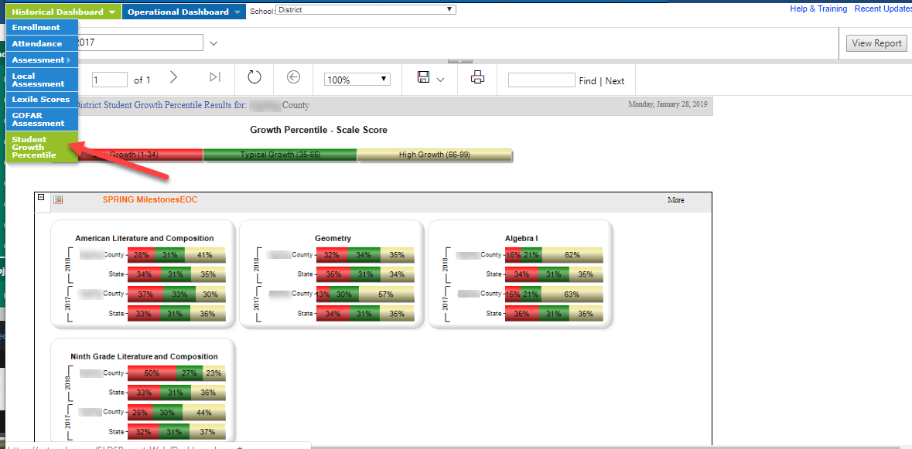
Student Growth Percentage Reports

Slide 58
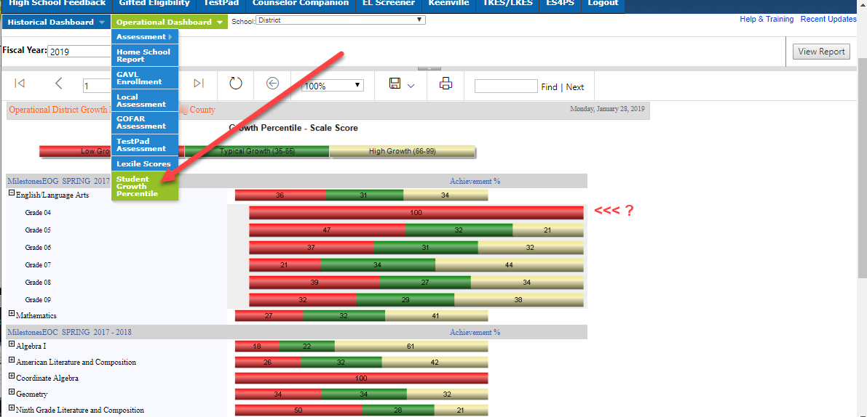
Student Growth Percentage Reports

Slide 59
School Improvement Dashboard

Slide 60
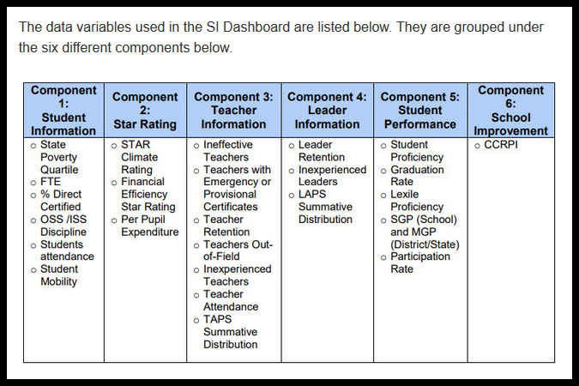

Slide 61
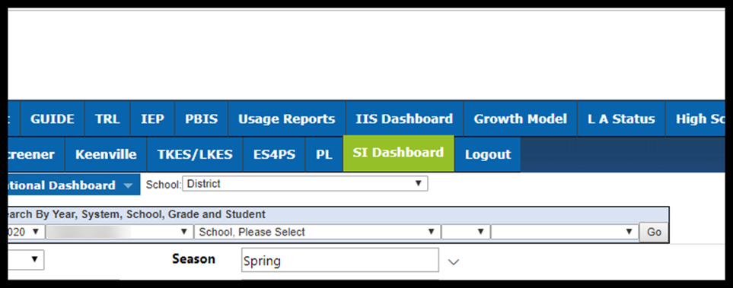

Slide 62
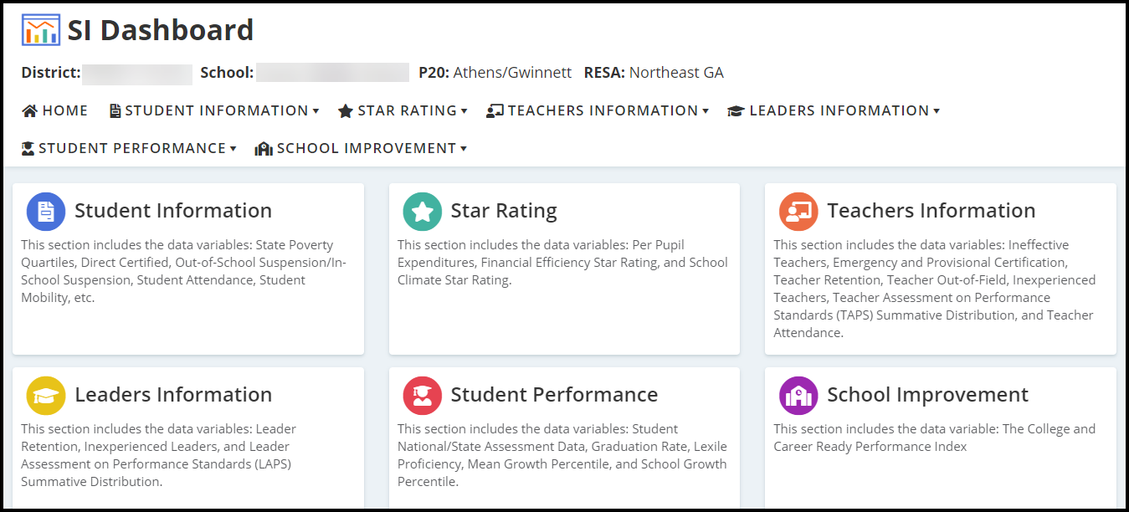

Slide 63
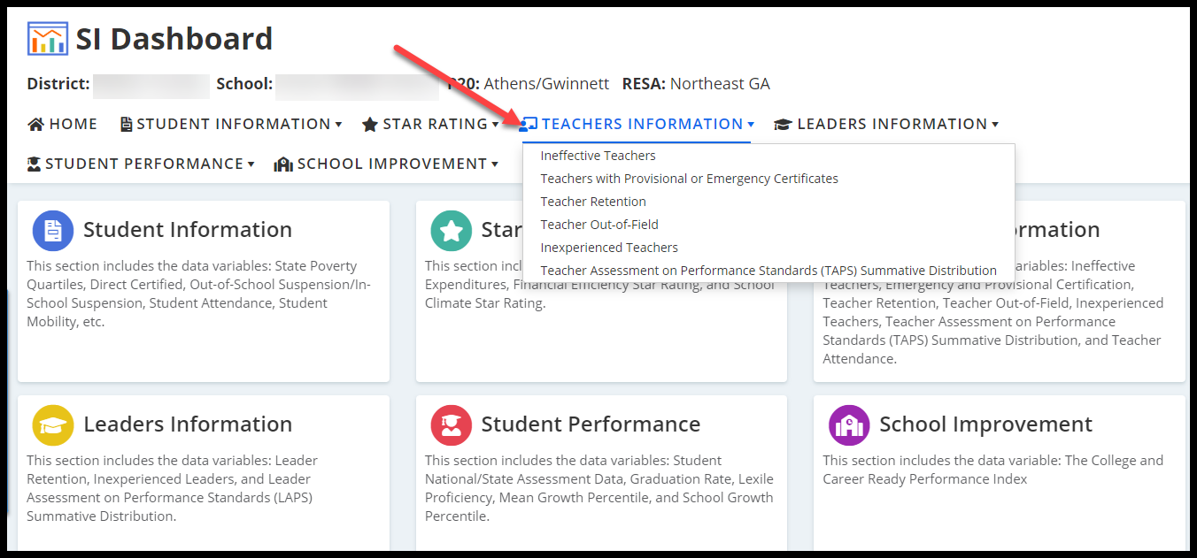

Slide 65
Student Profile Page

Slide 66
Downloadable Student Growth Reports

Slide 68
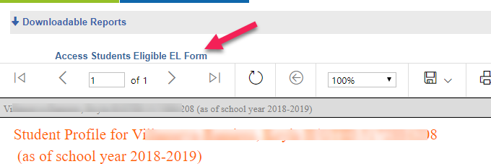
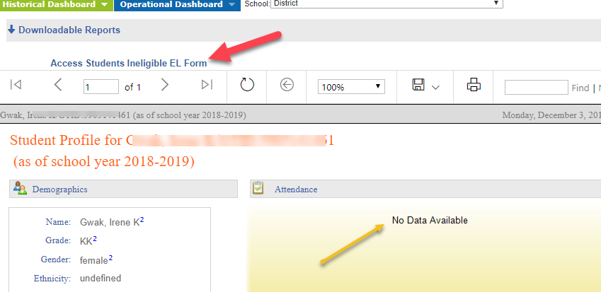

Slide 69
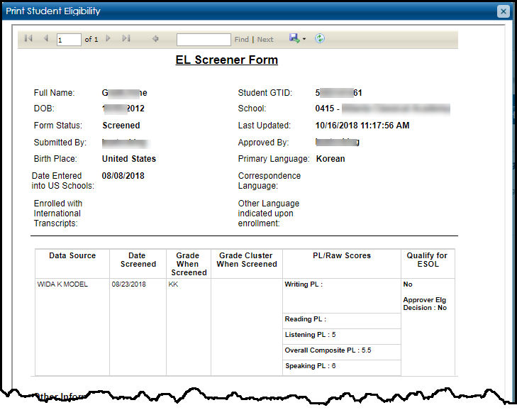

Slide 70
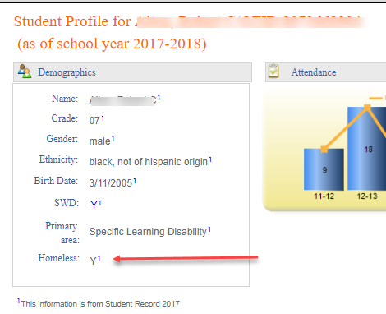

Slide 71
Equitable Services for Private School ES4PS

Slide 72
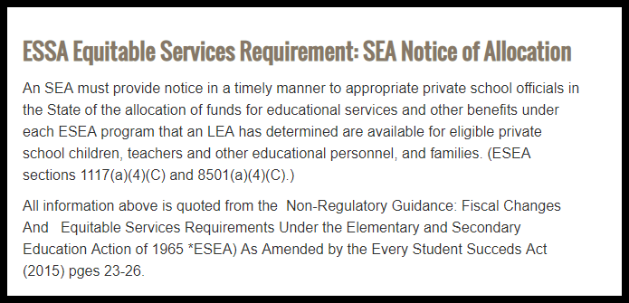
https://www.gadoe.org/School-Improvement/Federal-Programs/Pages/Allocations_and_Proportionate_Share_Archive.aspx

Slide 73
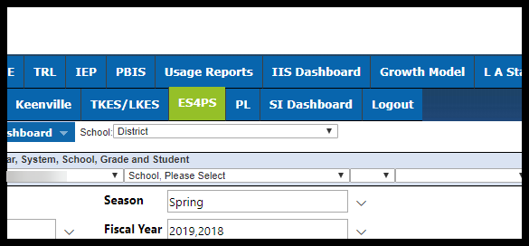

Slide 74
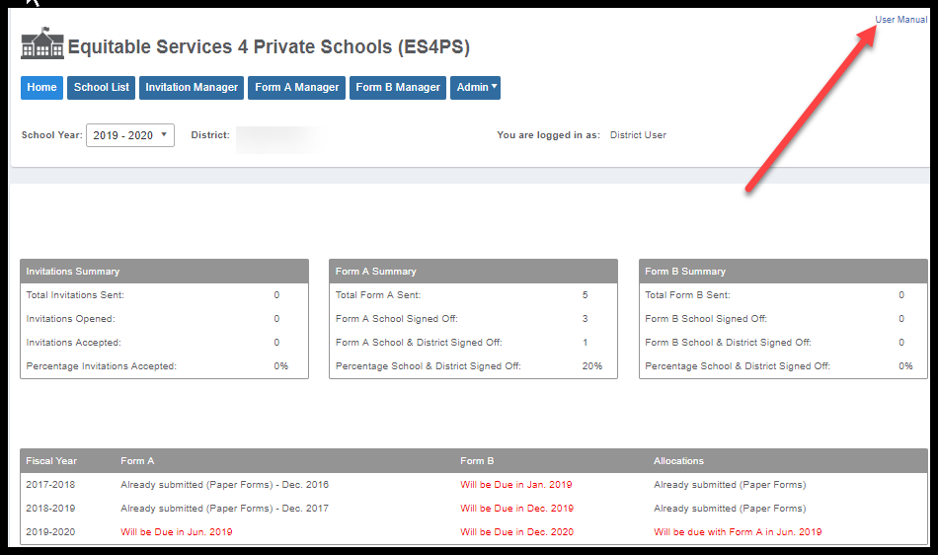

Slide 75
SST – MTSS – GTSSS
Pilot – October 2019
Expand Pilot – January 2020
ETA – State Aug 2020

Slide 78
To get confirmation that you attended this session please complete the digital sign-in with QR code.
slds@doe.k12.ga.us
email
slds.gadoe.org/Help
website

